Slide 1
COMP90007 Internet Technologies Workshop
Week 11 – Application Layer & Network Security
Ruixi
huor@student.unimelb.edu.au

Slide 2
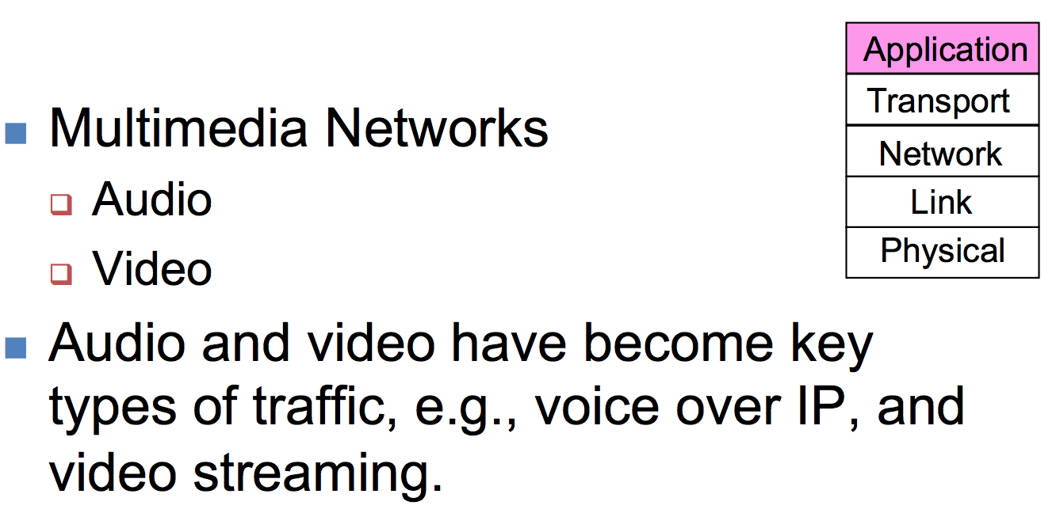
Multimedia

Slide 3
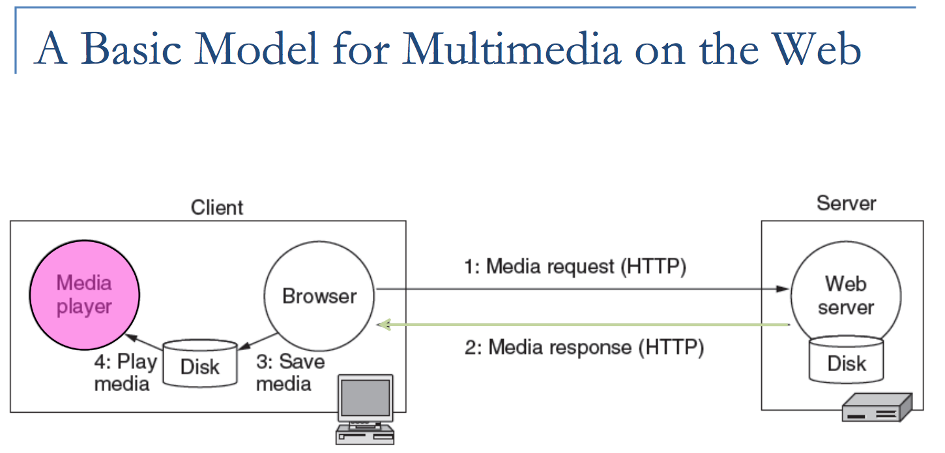
Multimedia
2 model:
The entire media file must be transmitted over the network before playback starts, causing delay in user experience

Slide 4
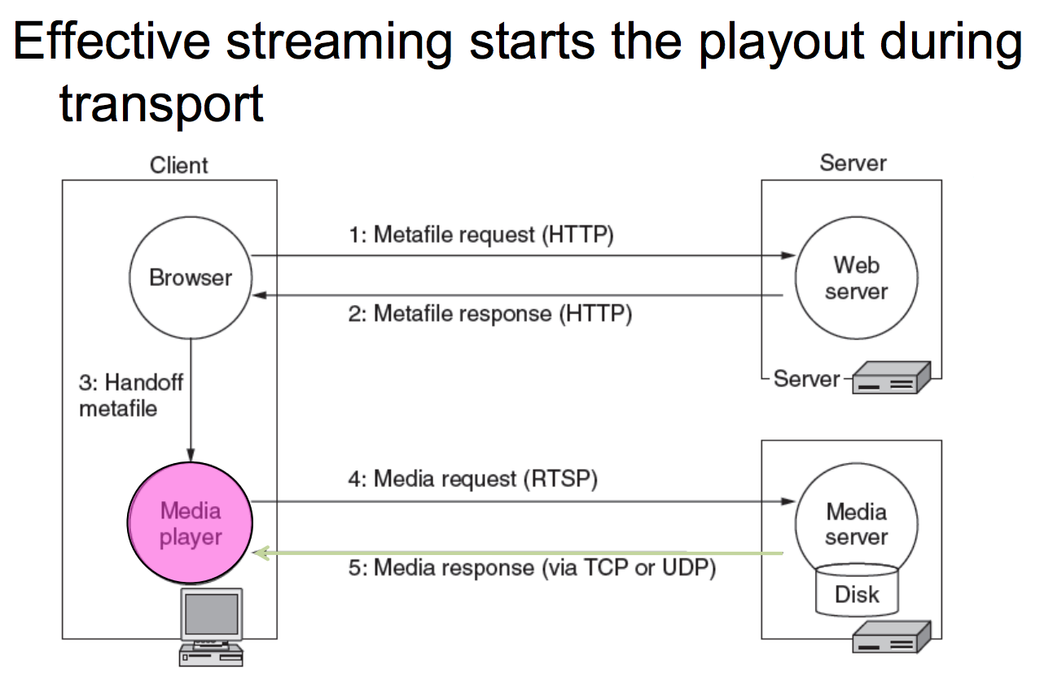
Multimedia
Streaming Media
2 model:

Slide 5
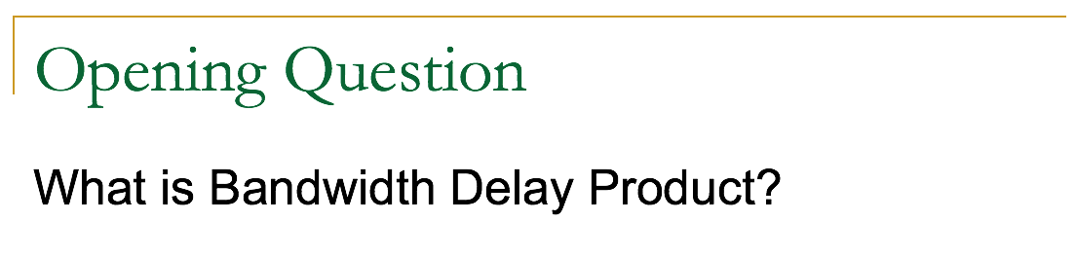
Bandwidth Delay product is an important measure of a link or network path. It is defined as the product of the bandwidth of a link and the delay of the link.
By “bandwidth” we mean the rate of the link or network path.
For “delay”, we will use the propagation delay. With this simplification we have:
BD = R x D

Slide 6
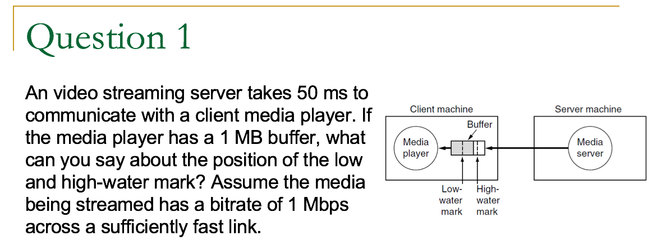
Why do we need a buffer here?

Slide 7
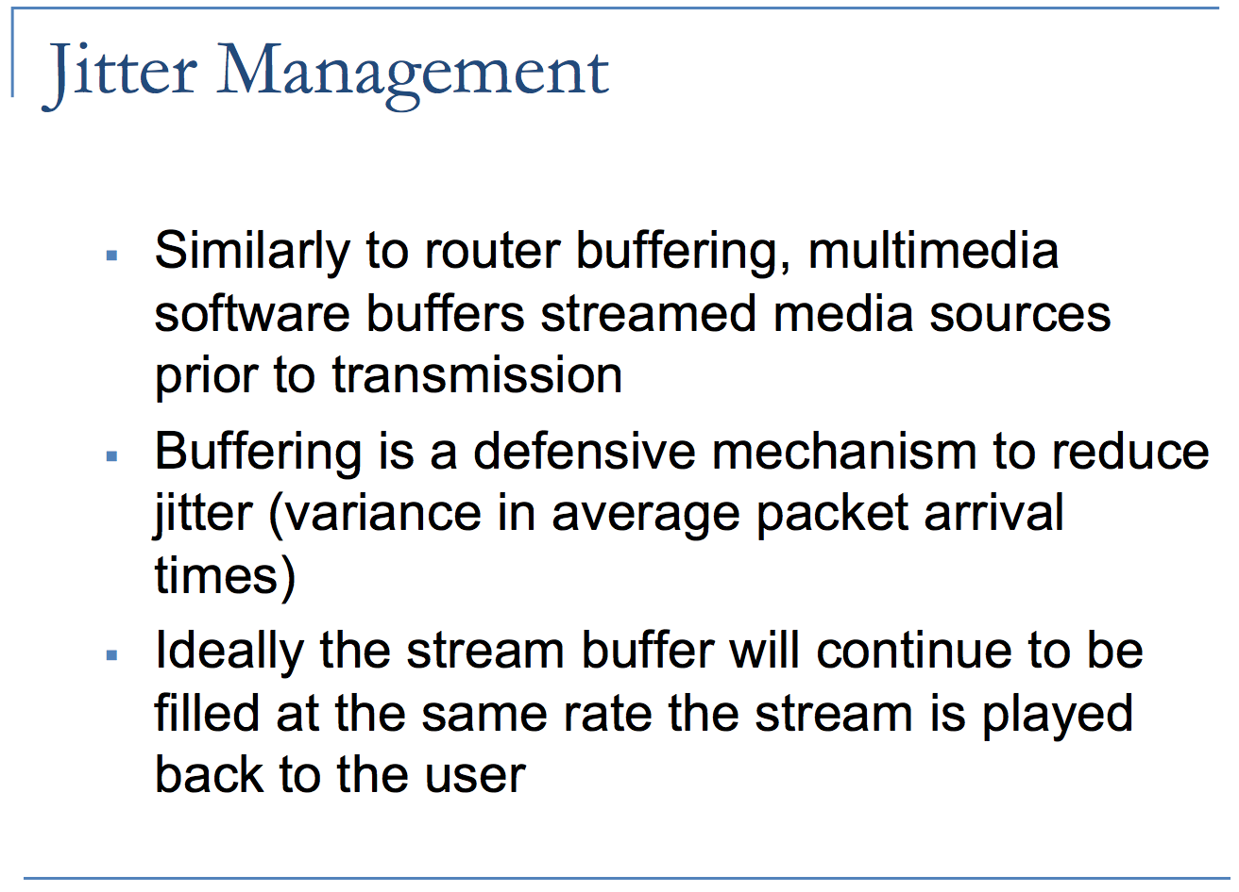

Slide 8
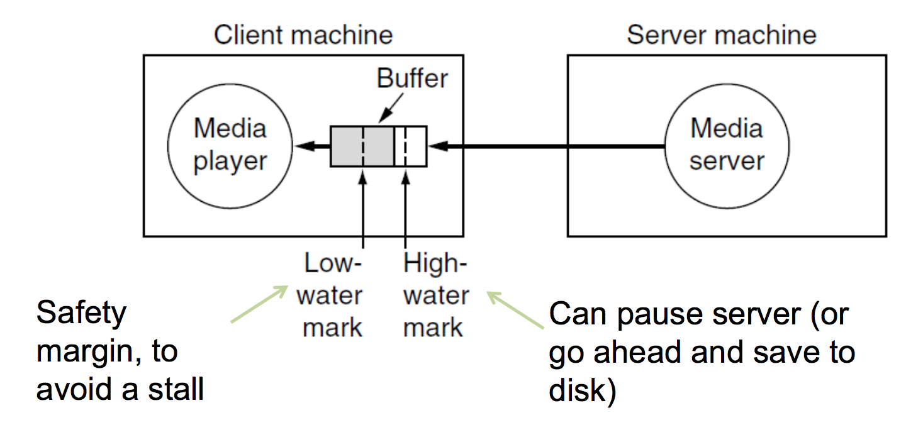
playing
transmitting

Slide 10
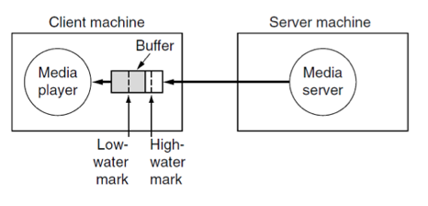
How to identify the position of high-water mark?
25,000 bytes
50 ms
Stop command
50 ms
It takes 50 ms to send a pause command to the server and another 50 ms for the data already in the network to drain after the server stops sending.
100 ms × 1 Mbps = 12,500 bytes will arrive, so the high-water mark should be at least 12,500 bytes below the top to avoid buffer overflow.
To be absolutely safe, set the mark to be 25,000 bytes from the top.

Slide 11
How to identify the position of low-water mark?
50 ms
Request data command
50 ms
25,000 bytes
Similarly, it takes 100 ms for the client to request data from the server and start receiving it. 12,500 bytes will be played during this time.
Hence, the low-water mark should be at least 12,500 bytes and probably 25,000 bytes to be safe.

Slide 12
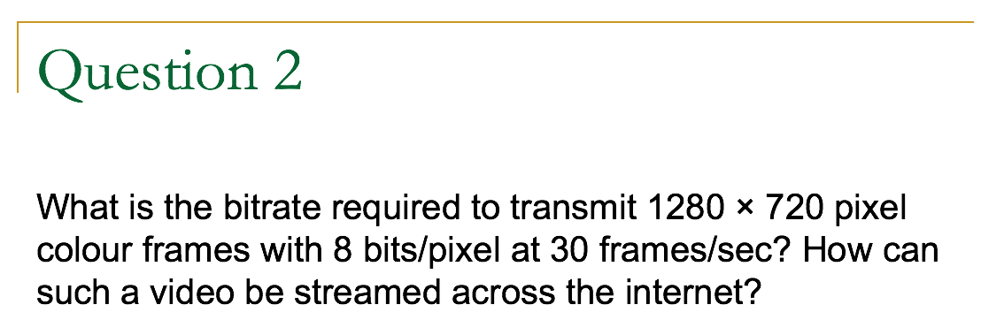
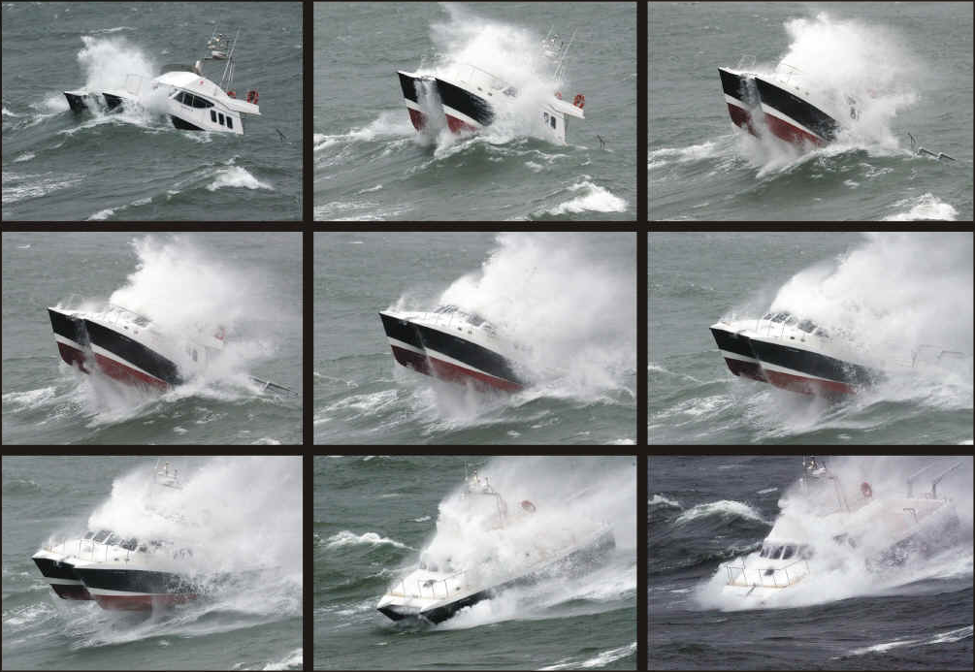
Answer:
30 frames/sec × 1280×720 pixels/sec = 27.648 megapixels/sec
27.648×10⁶ × 8 bits/sec = 221.2 Mbps (!!)
Assuming 70% compression ratio of each image: = 66.36 Mbps (!)
Solution: use video compression techniques –
encode the differences from each frame to the next

Slide 13
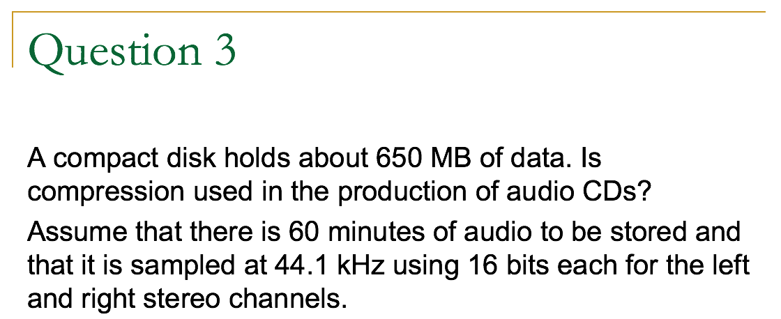
Answer:
Data rate of audio: 44.1×10³ × 16 × 2
= 1.411 Mbps
= 176 kB/s
Size required for 60 min of audio: 176 kB/s × 60×60 sec = 634 MB
∴ Compression is not used.

Slide 14
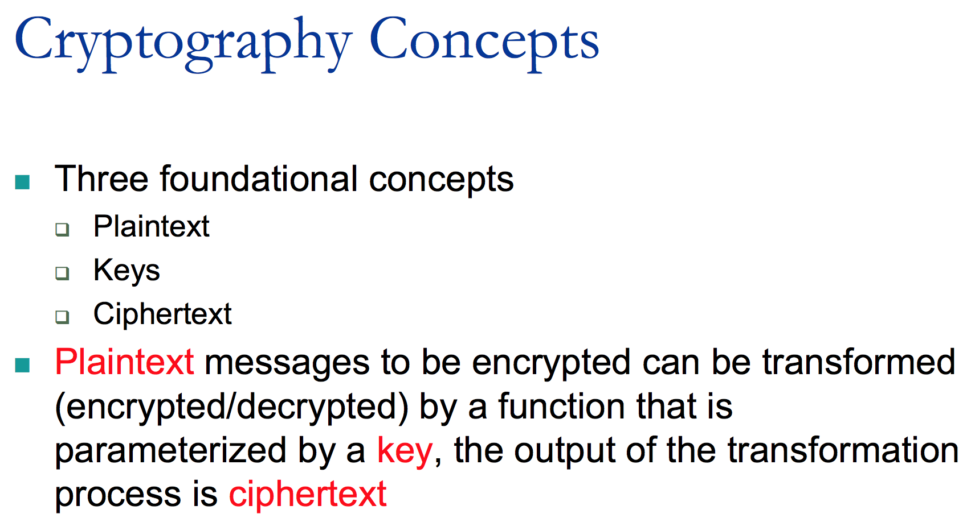

Slide 15
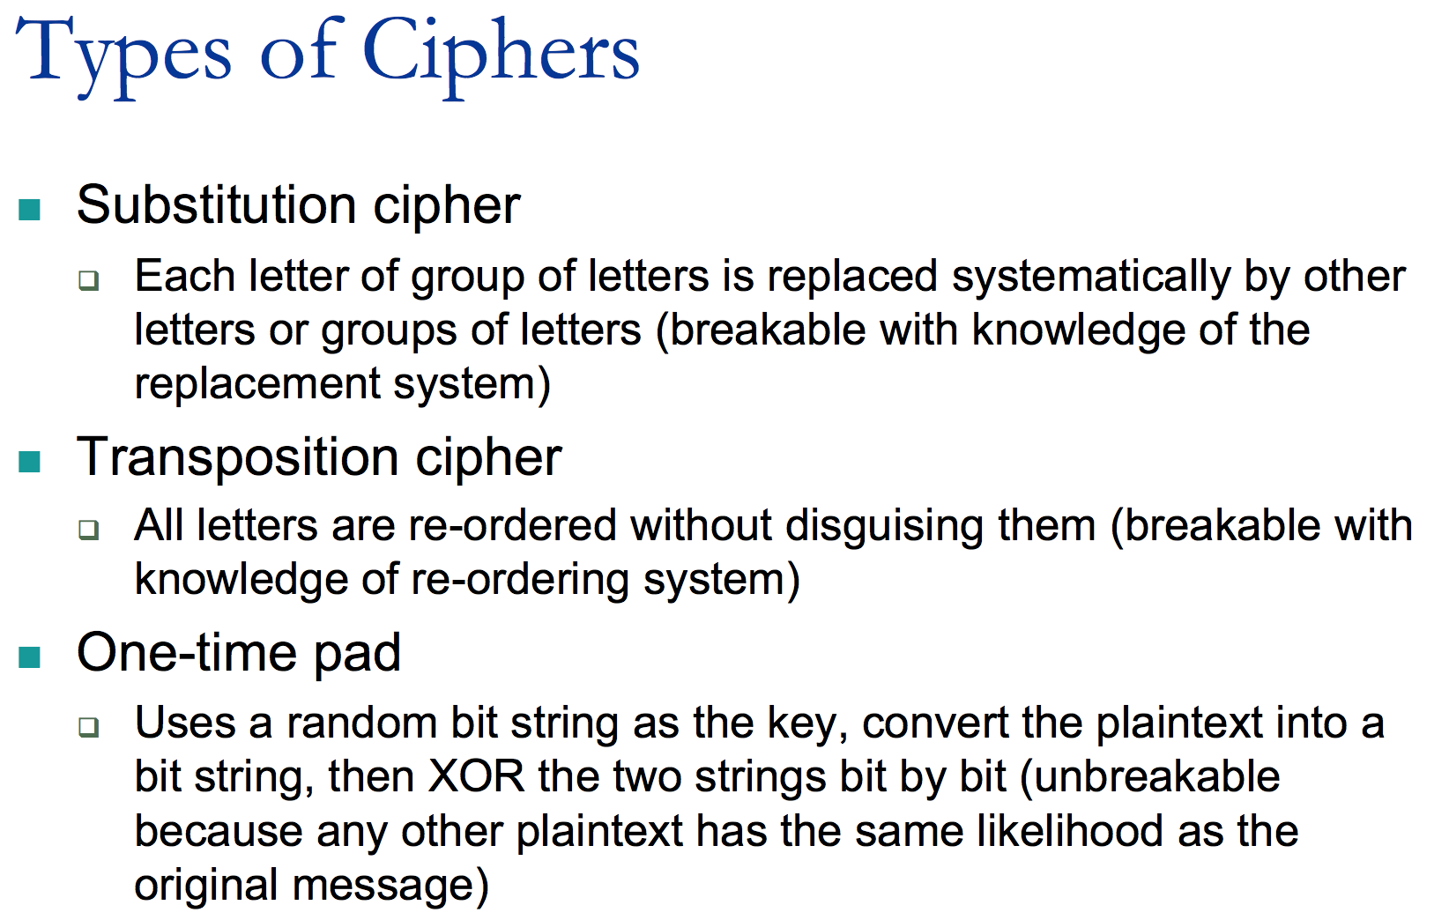
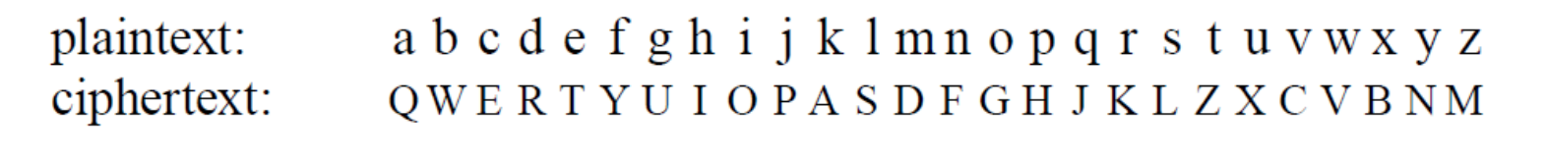

Slide 16

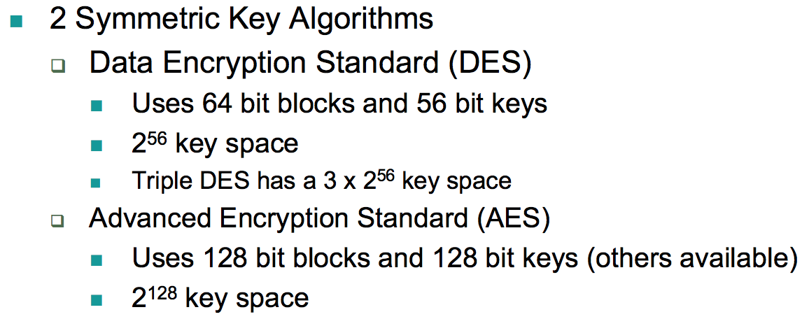
a block = 64 bit
plaintext
56 bit keys
ciphertext

Slide 17
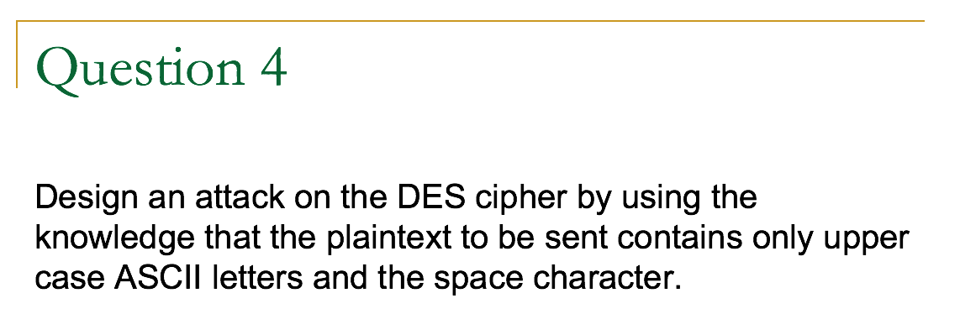
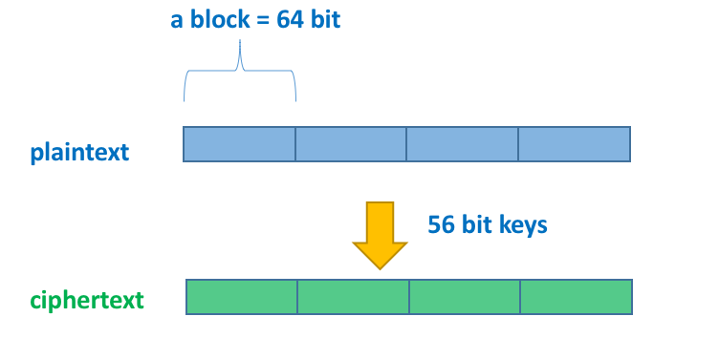
Answer:
Take the first block, and try keys until the plaintext only contains legal characters.
Keep trying subsequent blocks while the key produces only legal characters. If the key produces an illegal character, go back to the first block and keep trying more keys.

Slide 18
Cipher Modes
Cipher Block Chaining Mode
Cipher Feedback Mode
Stream Cipher Mode
Counter Mode

Slide 19
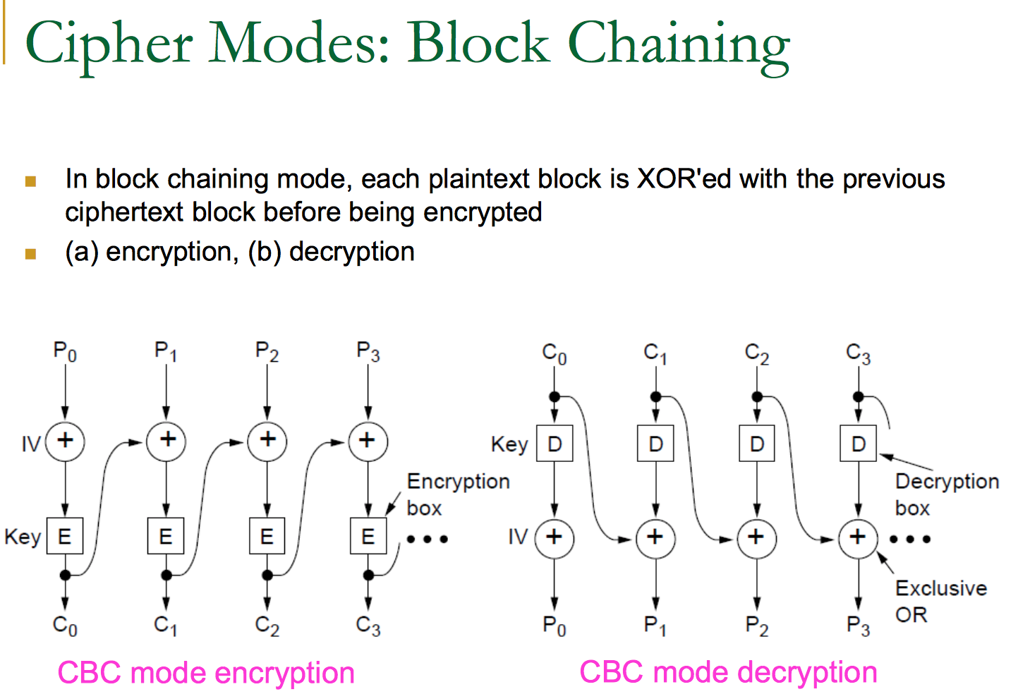
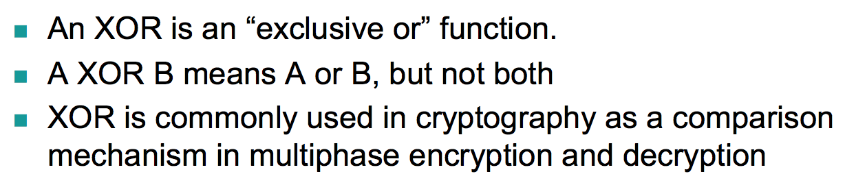
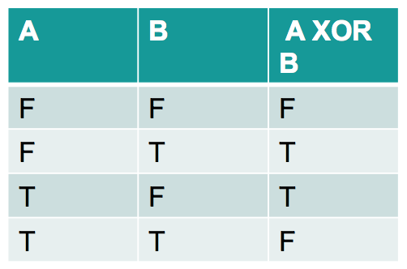
IV = initialization vector

Slide 20
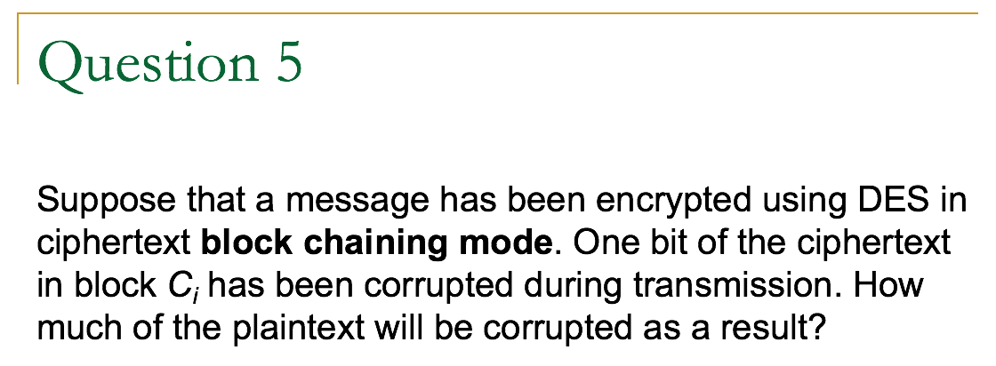
Answer:
If a single bit error occurs in C_{i} , then all of P_{i} is likely to be corrupted. C_{i} is then XOR'ed with D(C_{i+1}), which will cause a single bit error in P_{i+1}.
No other plaintext will then be corrupted. A single bit error thus only affects two plaintext blocks.

Slide 21
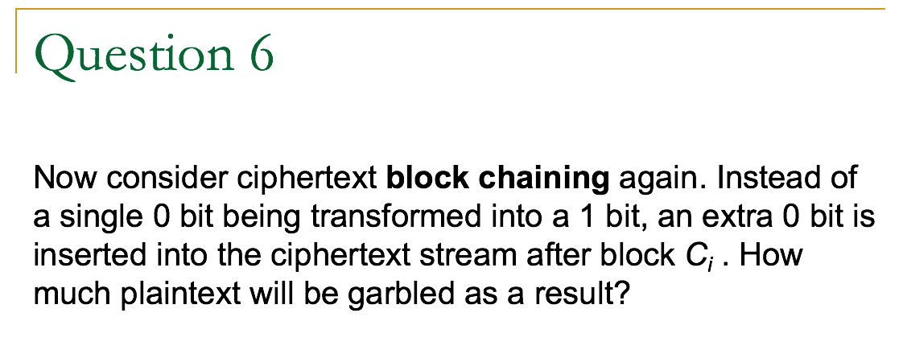
Answer:
Unfortunately, every plaintext block starting at P_{i+1} will be wrong now, since all the inputs to the XOR boxes will be wrong. A framing error is thus much more serious than an inverted bit.

Slide 22
Cipher Modes
Cipher Block Chaining Mode
Cipher Feedback Mode
Stream Cipher Mode
Counter Mode

Slide 23
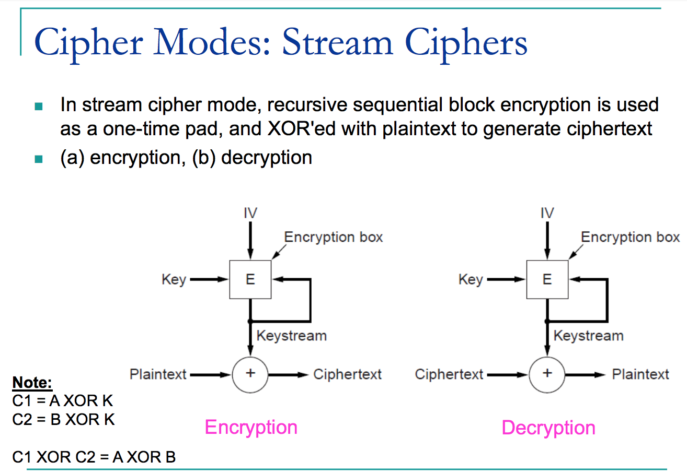

Slide 24
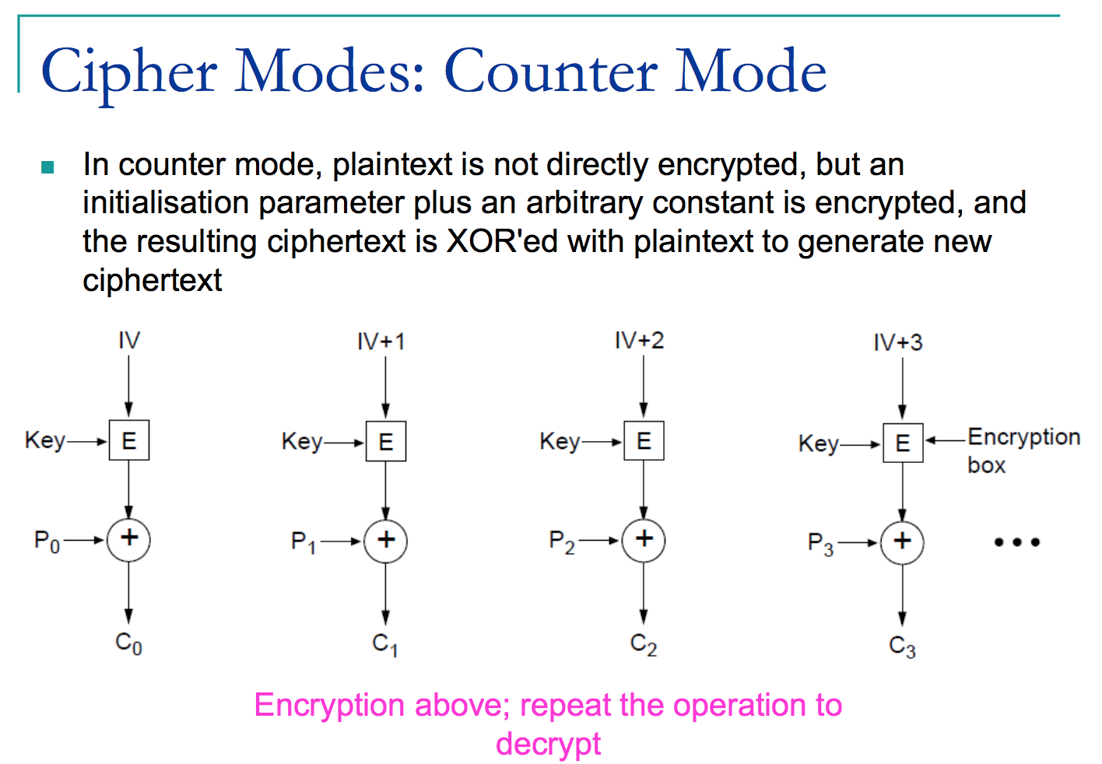
IV = initialization vector
Notes:
P0 XOR A = C0
C0 XOR A = P0 XOR A XOR A = P0
IV is random generated

Slide 25
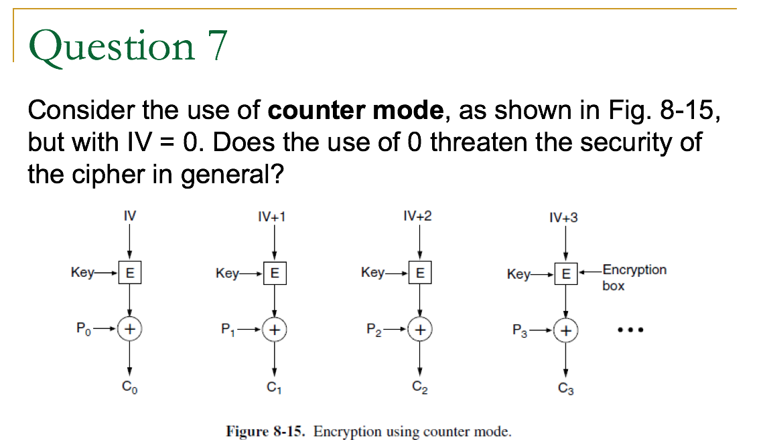
Answer:
No. The security is based on having a strong crypto algorithm and a long key. The IV is not really essential. The key is what matters.

Slide 26
